Slide 1
NLP Project Team 1
How we got F1-scores of 63.6% & 38.6%
Third place holder

Slide 2
Project Members
Iten Emad
Abdelrahman Jamal
Radwa Ahmed
Ayman Mohamed

Slide 3
Our best models
AraBert Transformer
XLM-Roberta
Random Forest
Fine-tuned on our given dataset.
Using the different dataset variants
Lr = 2e-5
Macro Average F1:
66% stance
43.84% category
Fine-tuned on our given dataset.
Using the different dataset variants
Macro Average F1:
63% stance
36% category
Tf-Idf along with CBOW and Skip-gram embeddings as our features.
Macro Average F1:
52% stane
30% category

Slide 4
Pipeline

Slide 5
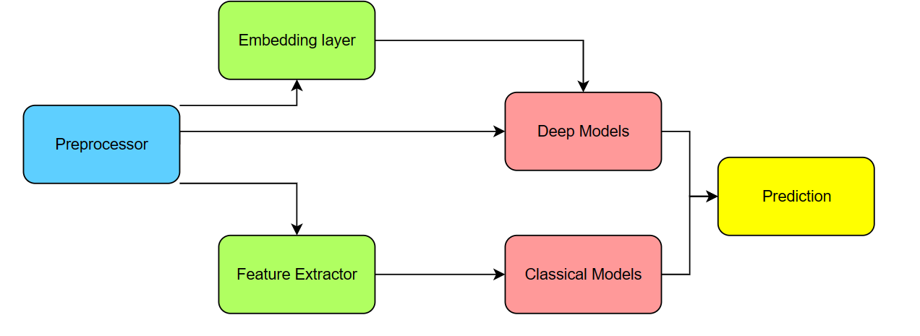
Our General Pipeline

Slide 6
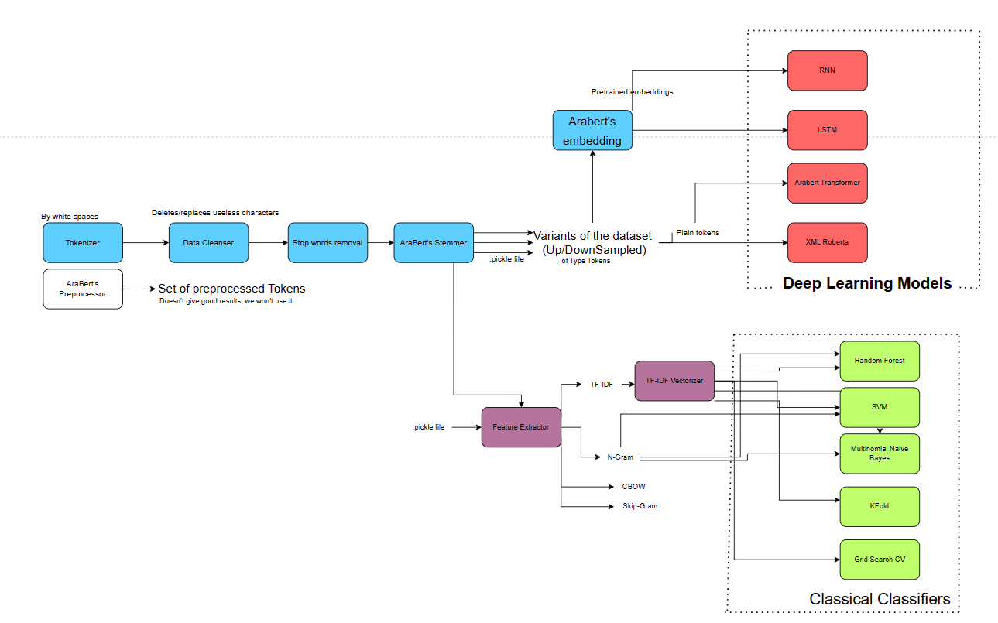
Our Detailed Pipeline

Slide 7
Dataset Cleansing

Slide 8
Dataset cleansing
Tokenization
Text normalization
Balancing data
Splitting by white spaces and punctuation
Removal of useless characters (tashkeel, character variants, etc.)
Stop words removal
stemming
Upsampling: using the original data, any extra data needed are sampled (ex: 500 to 1000)
Downsampling: Clipping our original data, reading only what we need (ex: 2500 to 1000)

Slide 9
Features

Slide 10
Proposed Features
Pre-trained embeddings
Fine-Tuned embeddings
Classical Features
AraBert’s embeddings.
XLM-Roberta
MarBert
QARiB
AraBert
Tf-idf
N-gram
Skip-gram
CBOW

Slide 11
Results

Slide 12
Using Arabert’s Transformer
Fine-Tuned on our dataset
Lr : 2e-5
Stance model dataset : Up/Downsampled to 1000 per class
Category model dataset : Up/Downsampled to 750 per category
10 epochs
Training time around 20-30 min
Macro Average F1: stances: 66%
43.84% for categories.
Accuracy stances: 81.1%
58.8% for categories

Slide 13
Thank
you!

